Slide 1
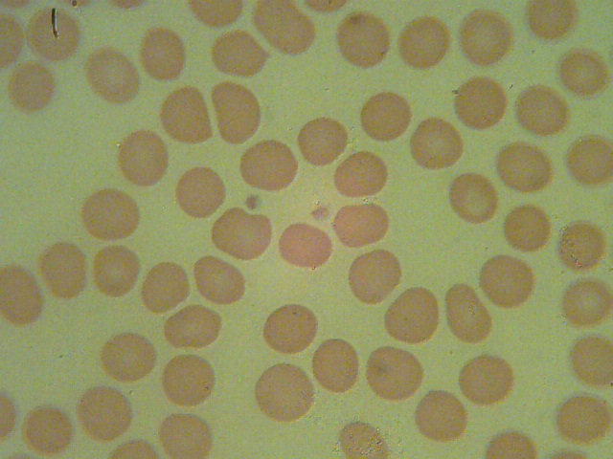
Red blood cells and platelets

Slide 2
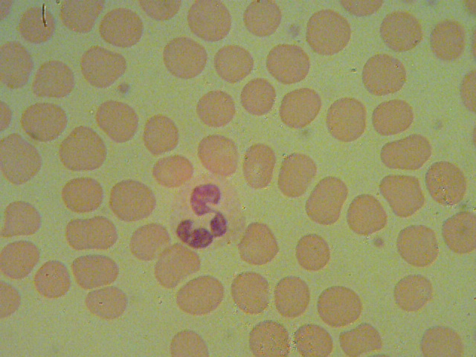
Immature neutrophile S-shaped

Slide 3
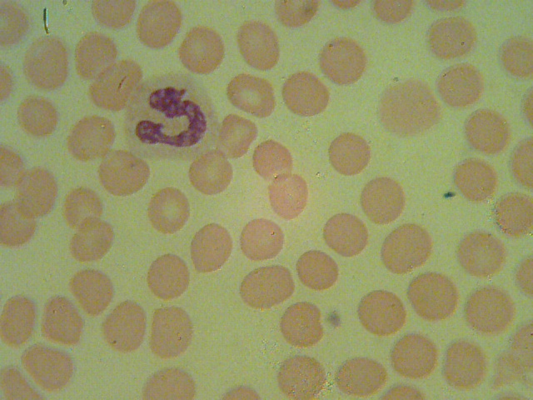
Immature neutrophile C- Shaped

Slide 4
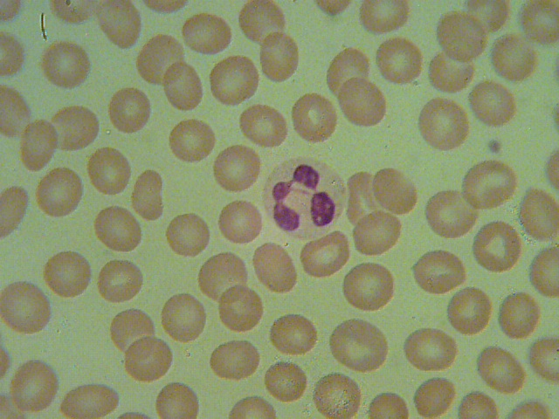
White blood cell, mature neutrophil

Slide 5
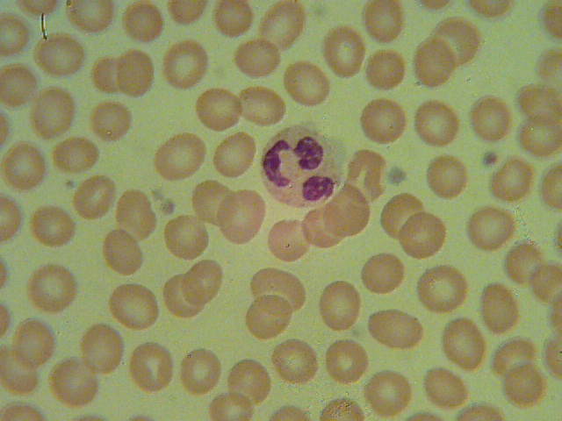
White blood cell, mature neutrophil

Slide 6
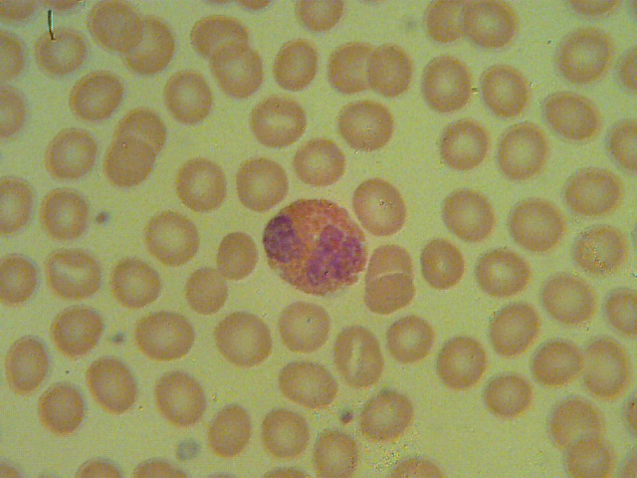
White blood cell, mature eosinophil
granules

Slide 7
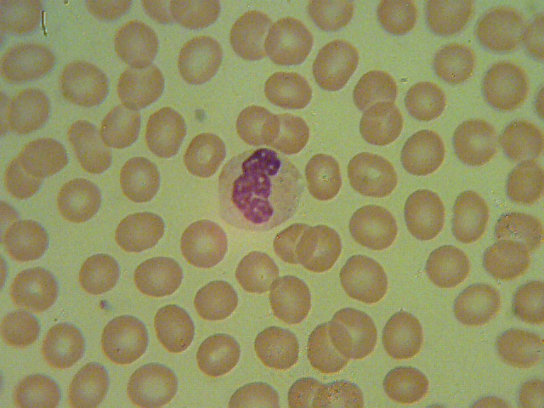
White blood cell , mature basophile

Slide 8
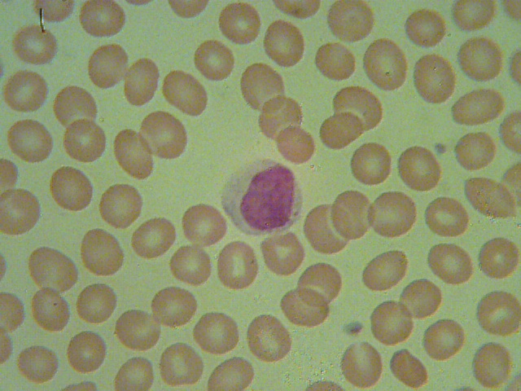
White blood cell, mature lymphocyte

Slide 9
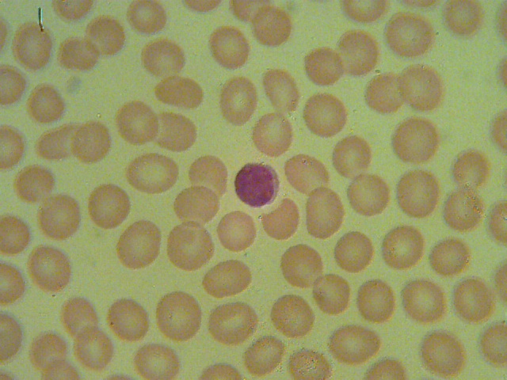
White blood cell, mature lymphocyte

Slide 10
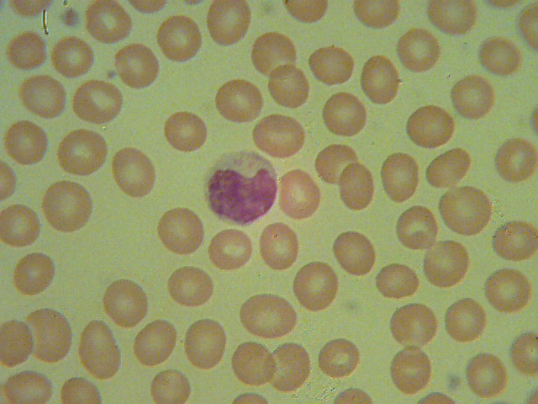
White blood cell, mature monocyte

Slide 11
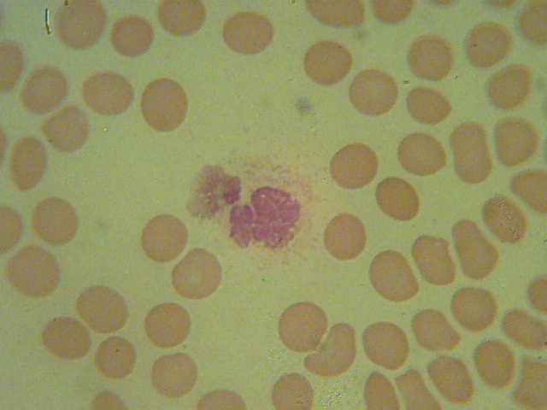
Megakaryocyte

Slide 12
Red blood cells and platelets

